Slide 1

AIRPORT MANAGEMENT SYSTEM
18CSC303J-DBMS Project

Slide 2

TEAM MEMBERS
Mahima Khatri RA1911003010761
Mudit Jindal RA191103010762
Charvy Gugalia RA1911003010767

Slide 3

ABSTRACT

Slide 4
Abstract
Airport Management System is a web application, developed to maintain the details of passengers, security personnel and flight staff in an airport. It maintains the information about the personal details of the passengers and their bookings. The passengers have the ability to generate and download their flight ticket in a pdf format. The details of the security personnel and the flight staff for each flight is also stored. They can log in and perform their respective functionalities such as clearing and checking in passengers and generating the flight report.
This system is an application developed in python3.5. It is user-friendly and very intuitive. It is fast and can perform many operations which are necessary for an airport. It is simple to understand and can even be used by people who are not even familiar with the workings of an airport.
This software package has been developed using HTML, CSS and Javascript at Front End and Django at Back End with Microsoft SQL Server database. This version of the software has a multi-user approach. For further enhancement or development of the package, user’s feedback will be considered.

Slide 5
ER DIAGRAM

Slide 6
ER Diagram
ER Diagram stands for Entity Relationship Diagram, also known as ERD is a diagram that displays the relationship of entity sets stored in a database. In other words, ER diagrams help to explain the logical structure of databases. ER diagrams are created based on three basic concepts: entities, attributes and relationships.

Slide 7
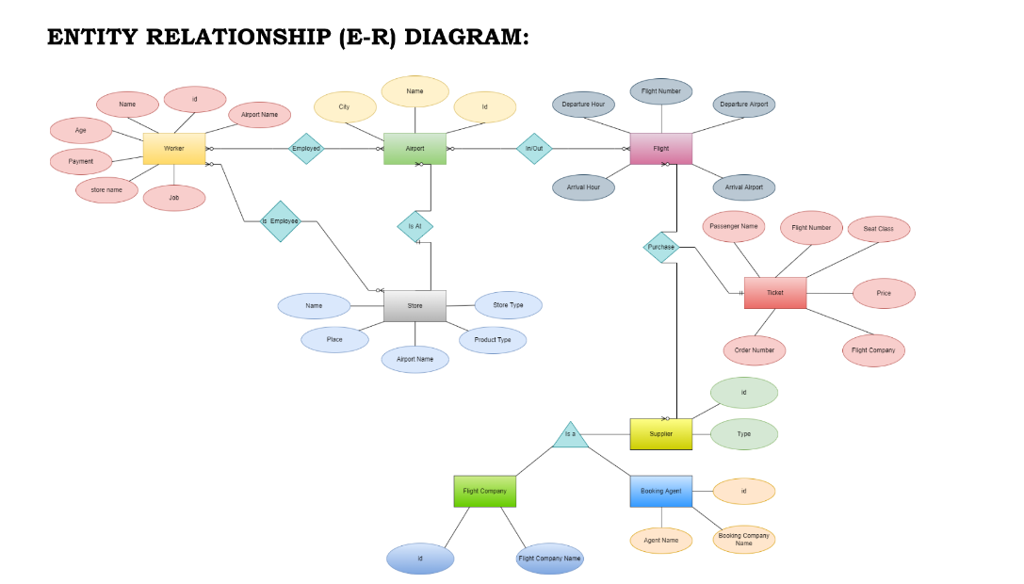

Slide 8
TABLES & CONSTRAINTS

Slide 9
1. TABLE – Worker
Attribute | Description | Data Type | Constraint
ID | Unique id of staff | int(20) | Primary Key
name | worker name | varchar(25) | NOT NULL
age | worker age | int(5) | NOT NULL
payment | Payment method | varchar(25) | NOT NULL
Store name | Name of the store | Varchar(35) | Foreign Key
job | Workers’s Job | varchar(35) | NOT NULL
Airport Name | Name of the Airport | varchar(35) | NOT NULL

Slide 10
The various users are:
1. Booking Agent: They would easily verify the names and information of the passengers travelling across a series of flight manifests. They would be able to clear passengers for their flight.
2. Workers: They would require information about passengers travelling in their respective flights. Before the flight, they generate a report of all checked in passengers who have cleared security. The report would contain details of number of passengers and their names.
3. Ticket: Passengers can use their unique booking ID and last name to access flight information and perform self check in. They can also search and book flights. Unique booking ID would be generated for each booking.

Slide 11
The data maintained would be as follows:
1. Ticket information: Maintain list of passengers and their respective flight information.
2. Flight information: Maintain list of flights and their departure/arrival timings along with the maximum size of passengers that could be accommodated on each flight

Slide 12
TECH STACK

Slide 13
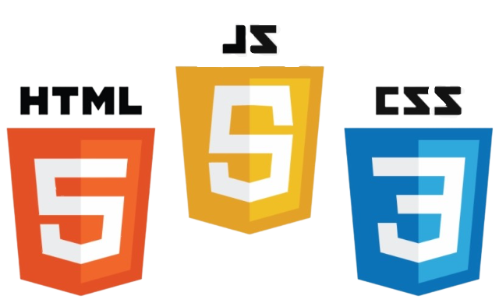


HTML
CSS
Java Script
Django
MySQL database

Slide 14
The End

